Slide 1
Time-Dependent Density Functional Theory (TDDFT) for Excited State Calculations

Slide 2
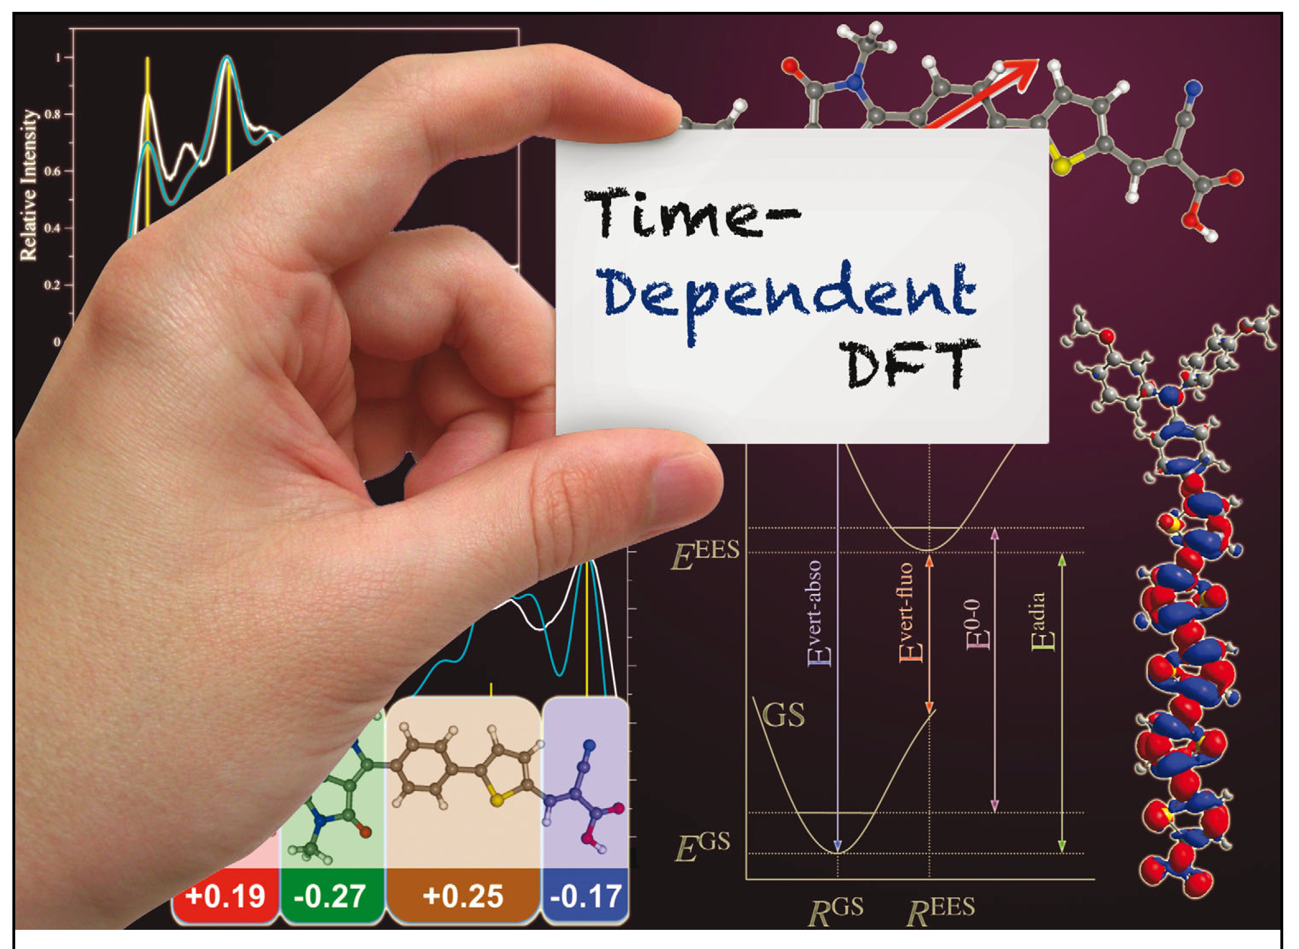

Slide 3
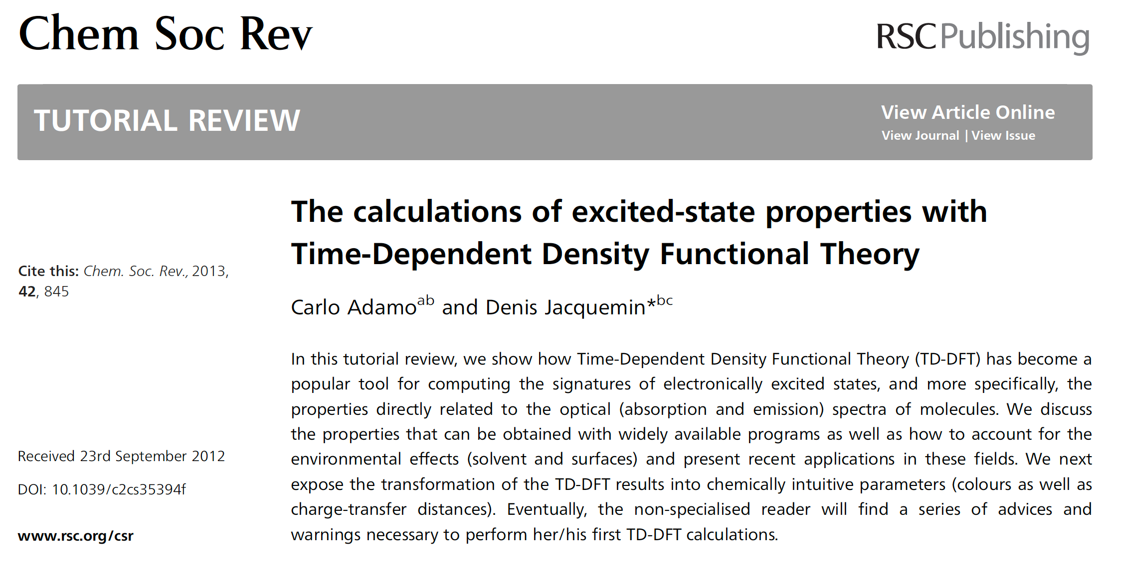
Paper 1

Slide 4
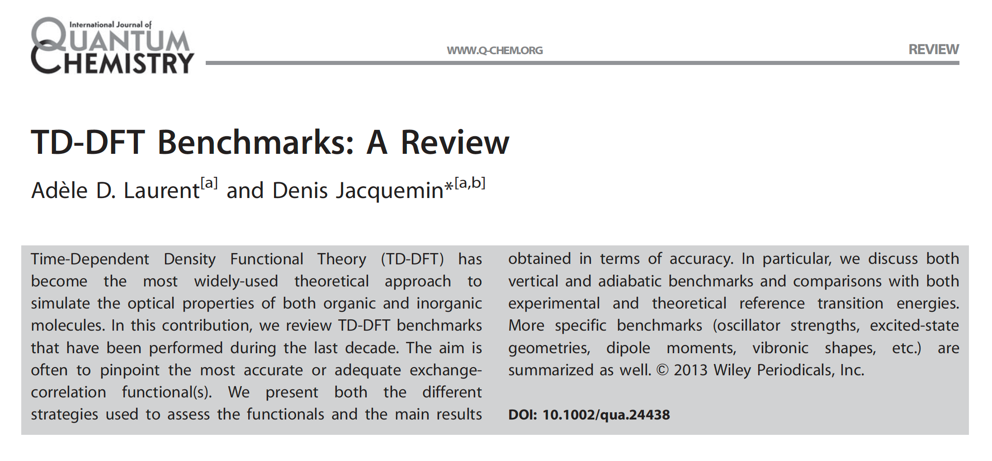
Paper 2

Slide 5
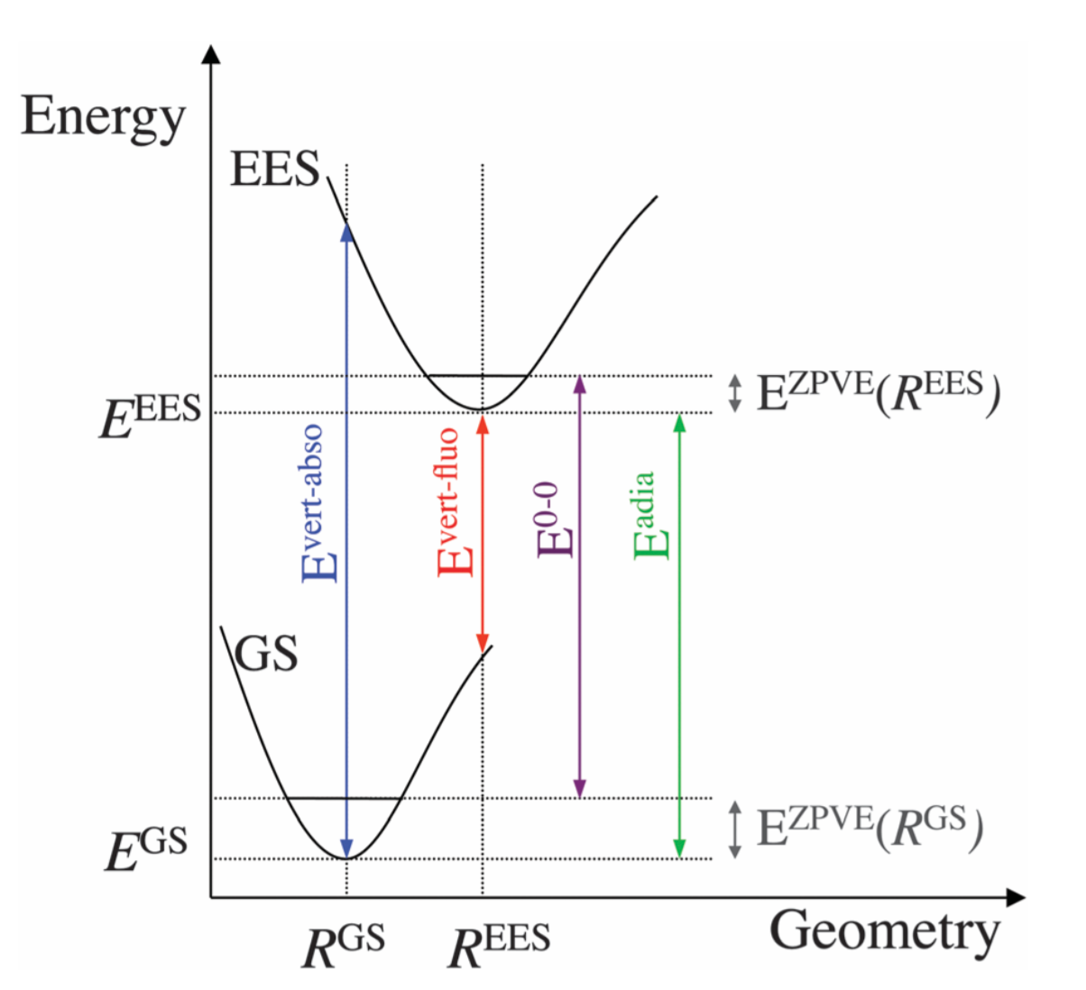
Jablonski Diagram

Slide 6
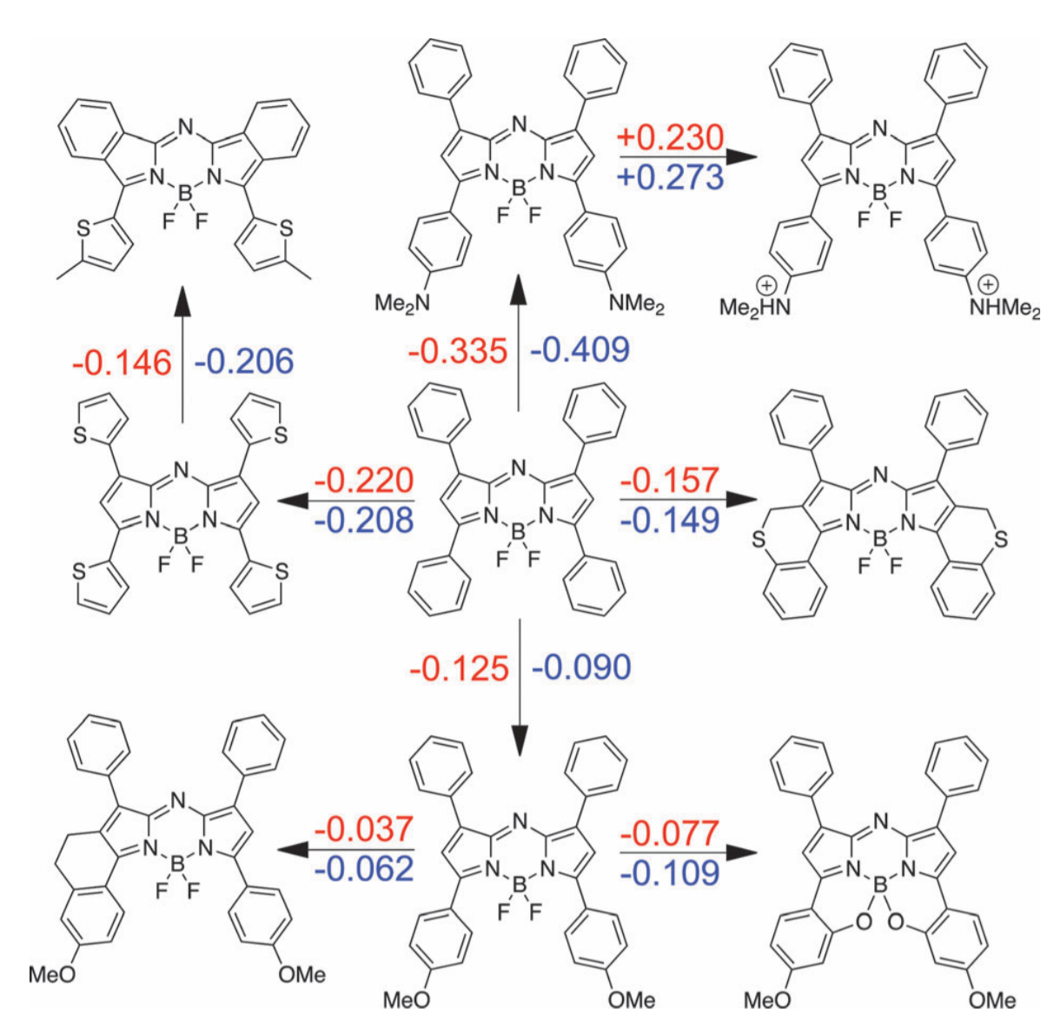
Chemical Effects on E₀₋₀

Slide 7
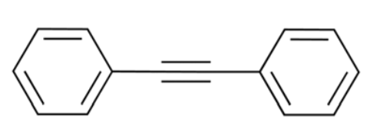
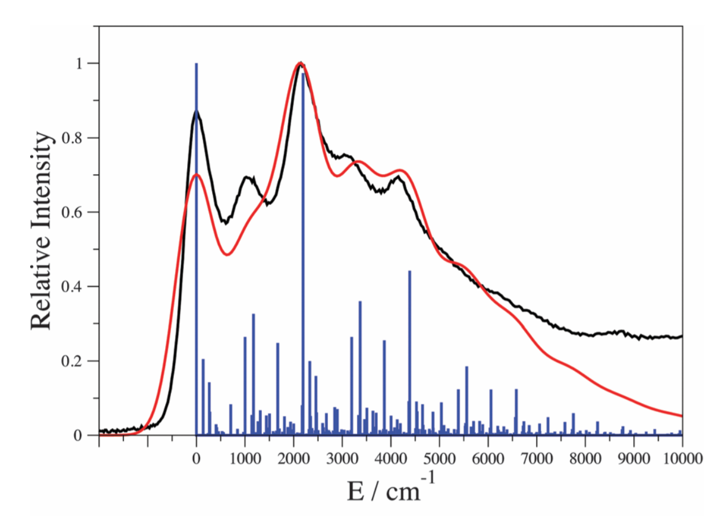
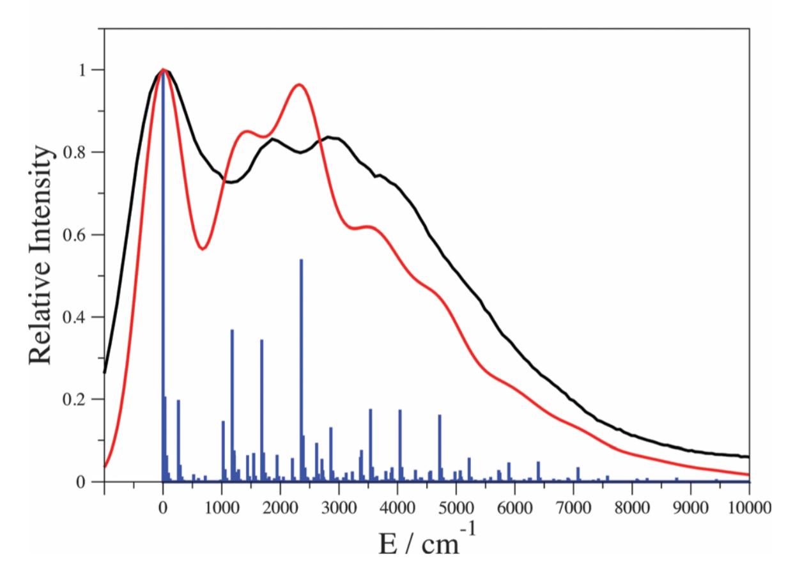
Absorption and Emission Spectra

Slide 8
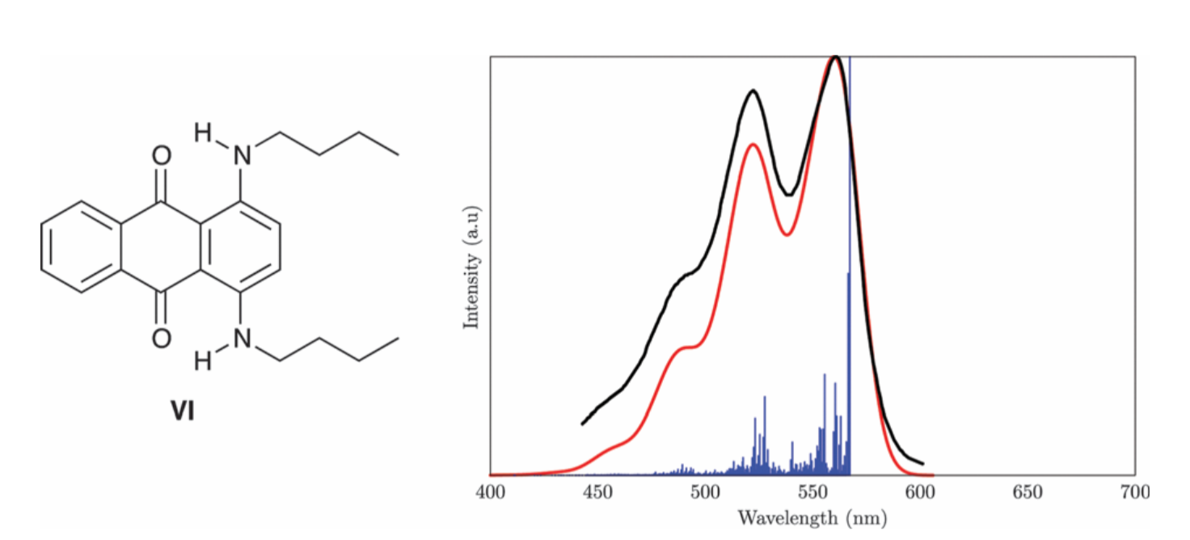
Absorption Spectra of Solvent Blue 35

Slide 9
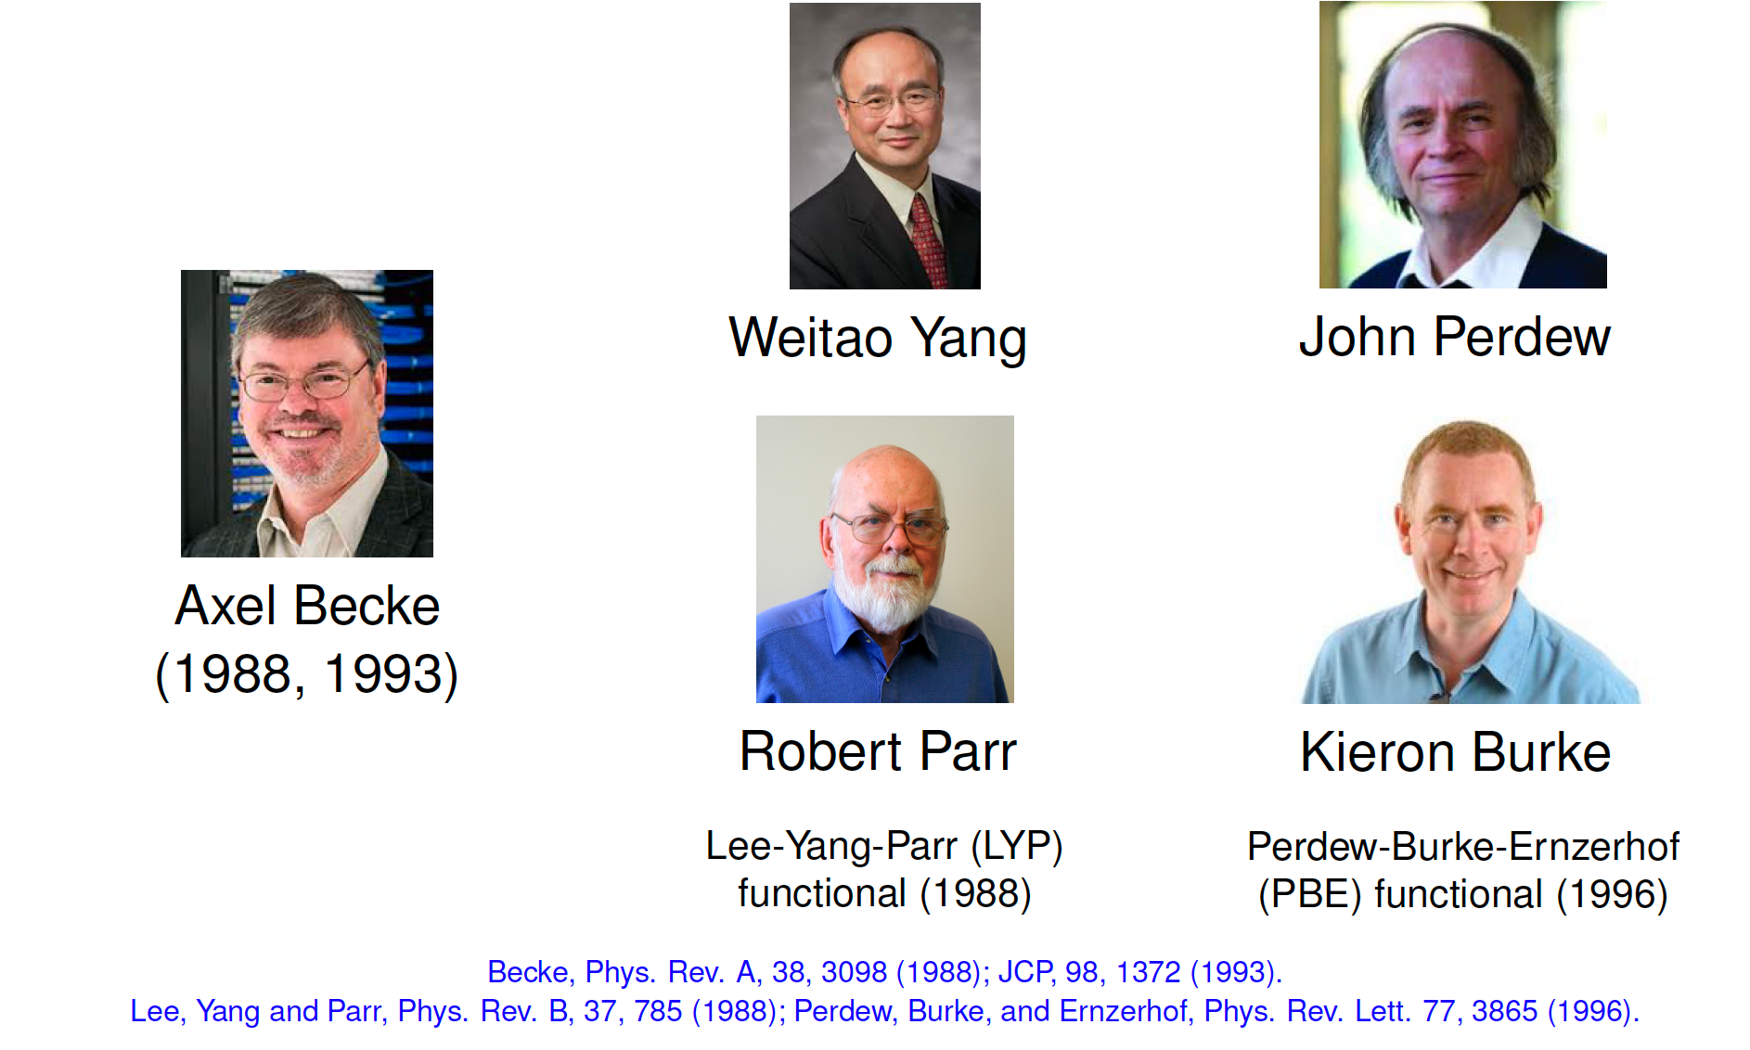
Modern Density Functionals

Slide 10
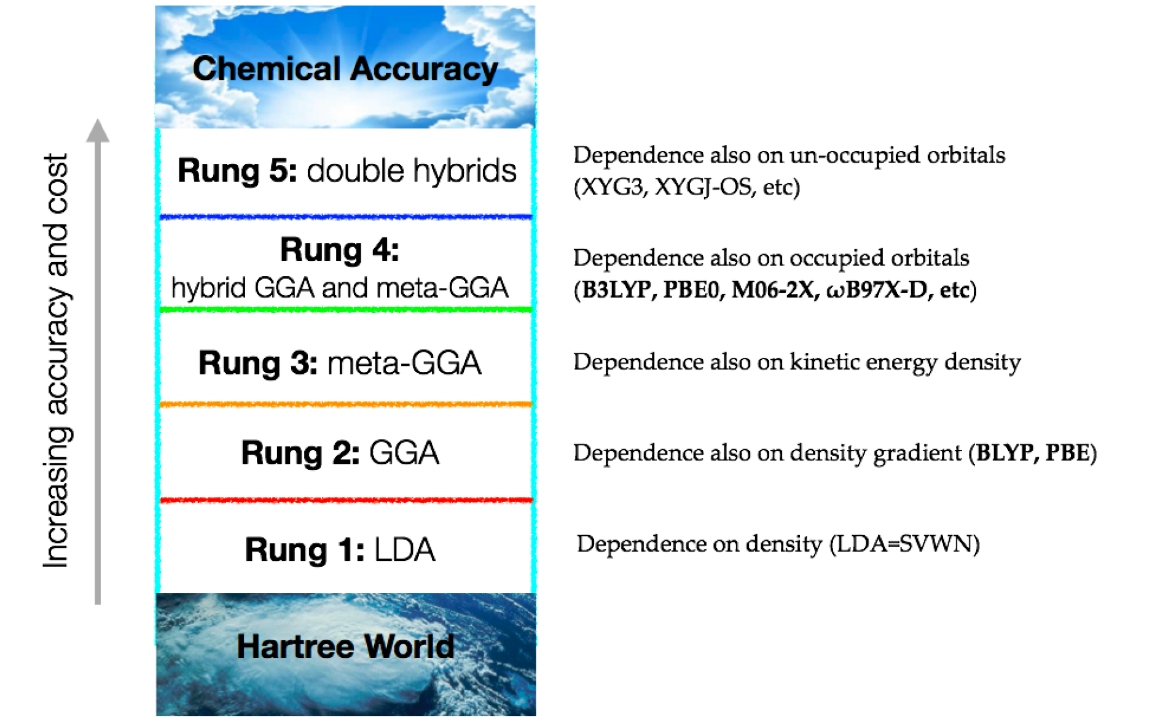
Five Rungs of Density Functionals

Slide 11
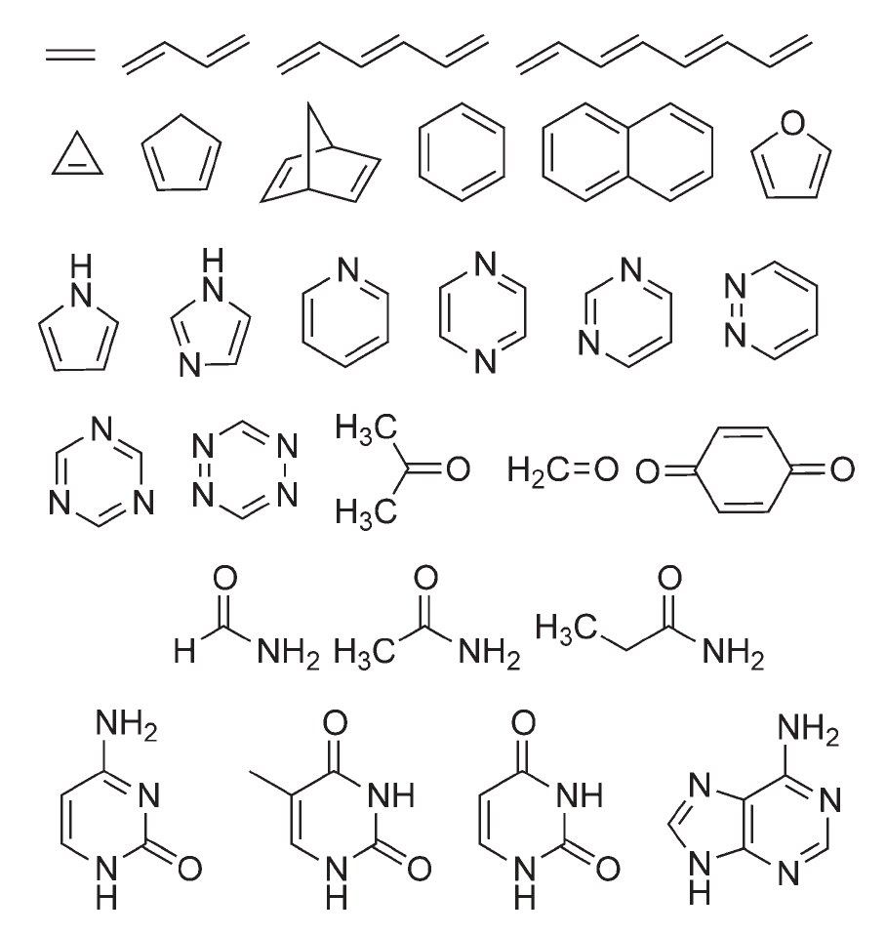
Thiel Set of Molecules (MSE and MAE wrt BTE)
RSHs
CAM-B3LYP, 0.22, 0.31
LRC-ωPBEh, 0.53, 0.50
ωB97X-D, 0.21, 0.30
M06-2X, 0.23, 0.34
Conventional Hybrids
B3LYP, -0.07, 0.27
PBE0, 0.05, 0.24
Pure Functionals
BLYP, -0.47, 0.54
PBE, -0.45, 0.53

Slide 12
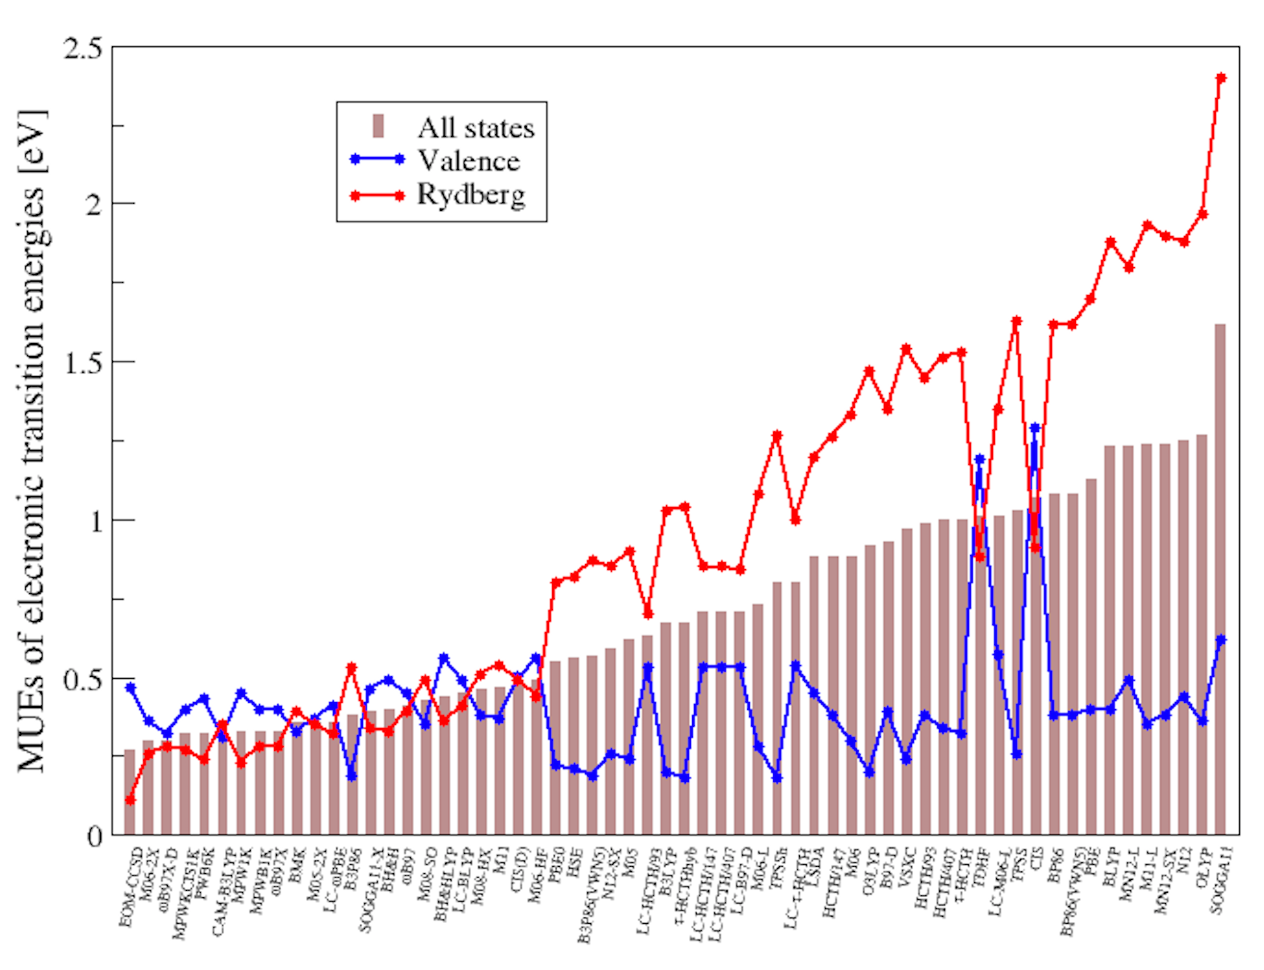
Truhlar Benchmarking Results

Slide 13
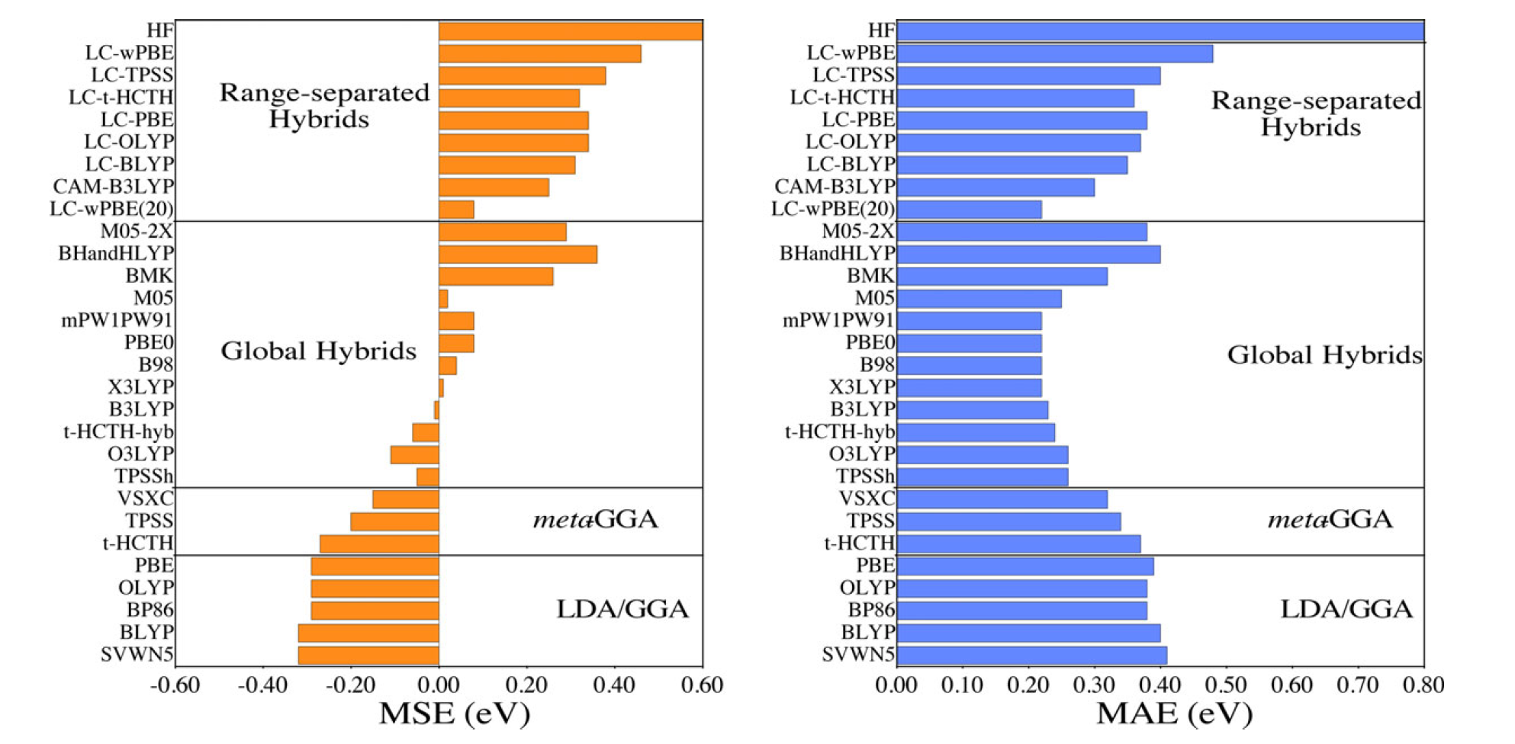
MSE and MAE wrt 614 Experimental λ_{max}

Slide 14
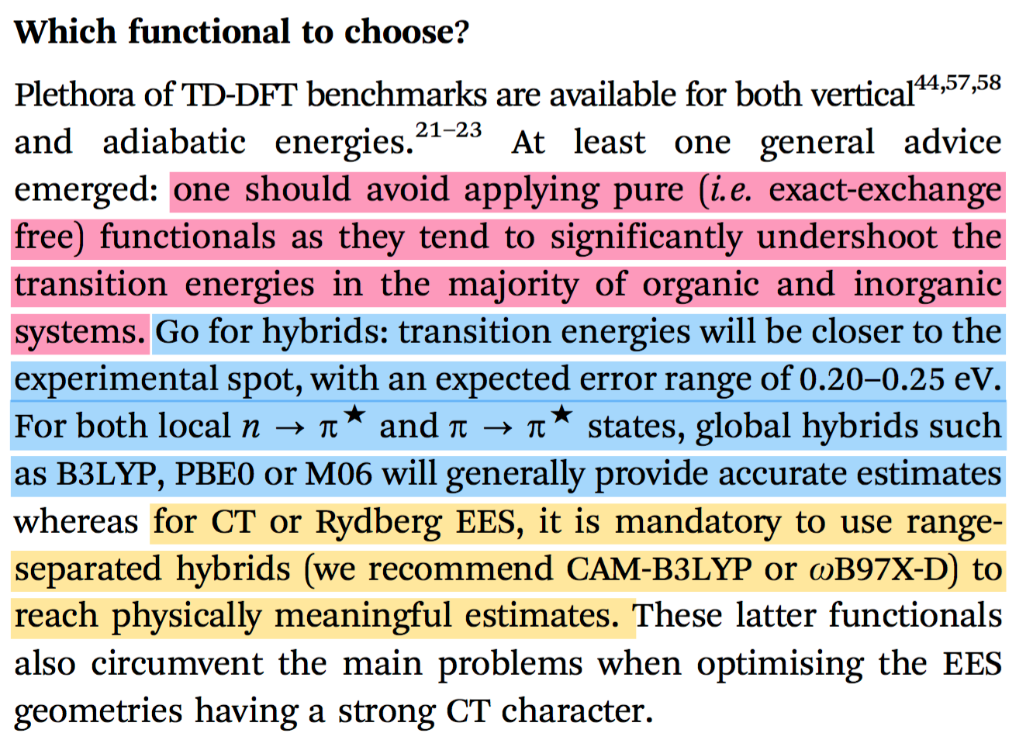
Which Functional To Choose

